Slide 1
PHASE 2 INOVATION: CHATBOT IN PYTHON

Slide 2
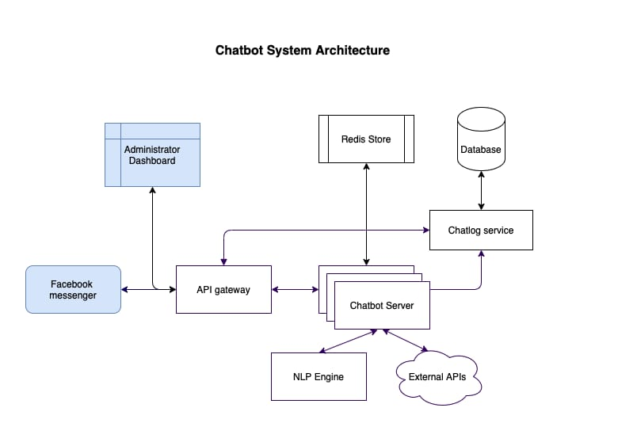
Architecture of chat bot

Slide 3
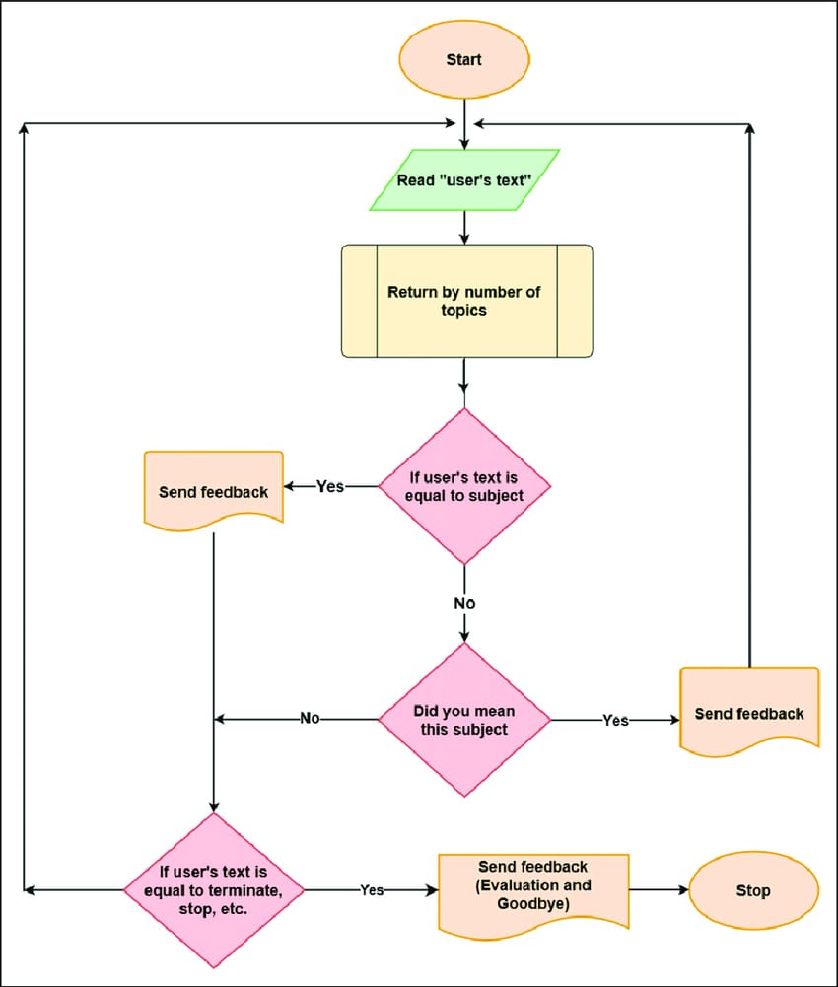
Flow chart

Slide 4
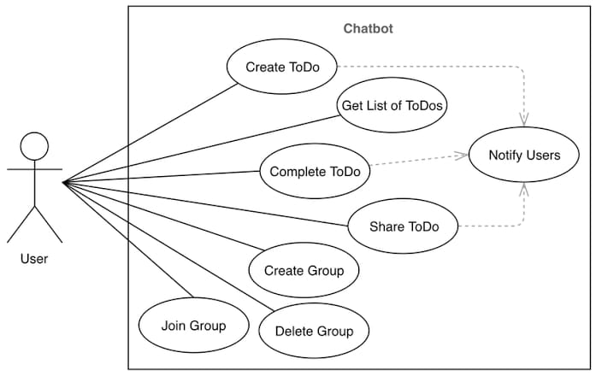
User Diagram

Slide 5
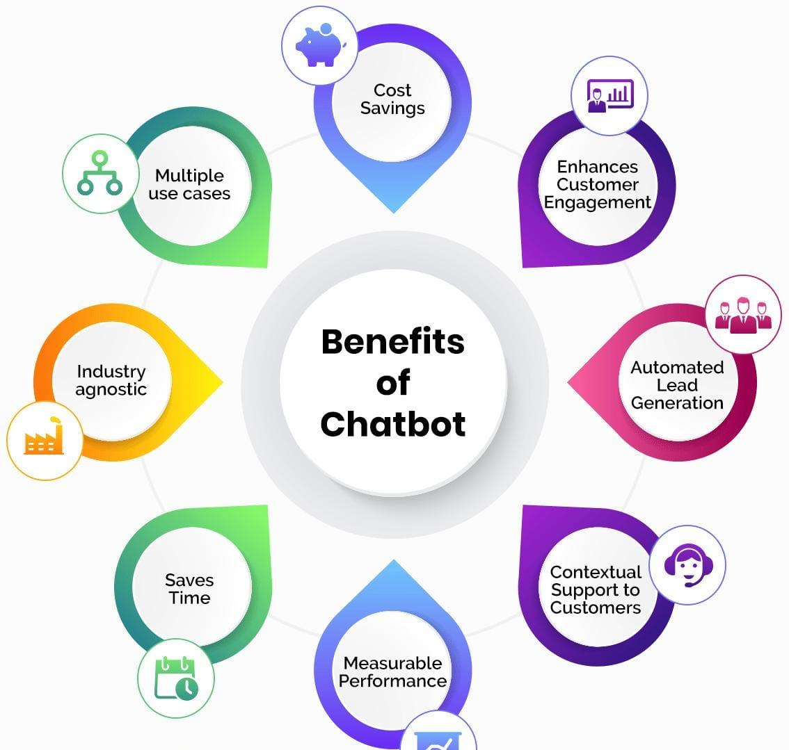
Benifits

